Slide 1
T H E V A L U E O F A P E R S O N

Slide 2
What is an Advertisement?
What is their purpose?
Why do we have them?
What are some modern ways we advertise today?
What sort of items and services do we advertise?
Notes:
Begin by discussing modern day advertisements. What is their purpose? Why do we have them? What are some modern ways we advertise today? What sort of items and services do we advertise?

Slide 3
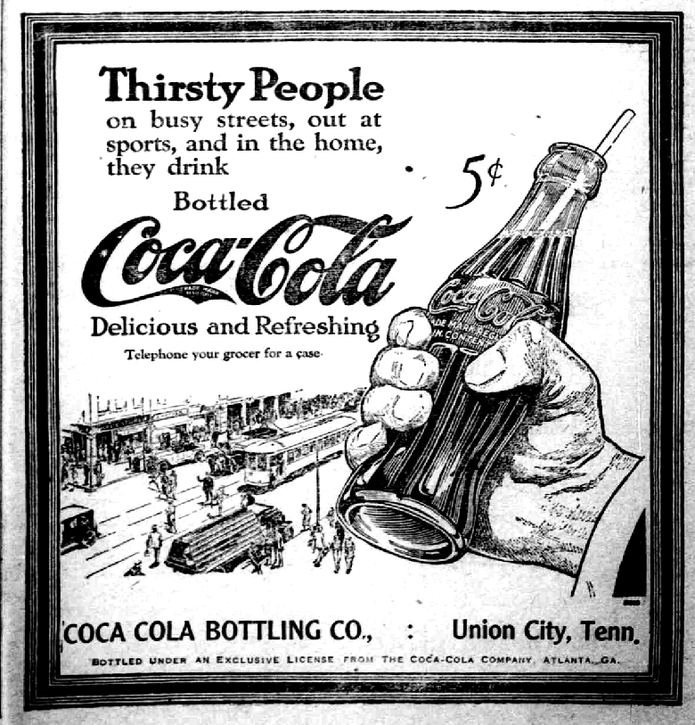
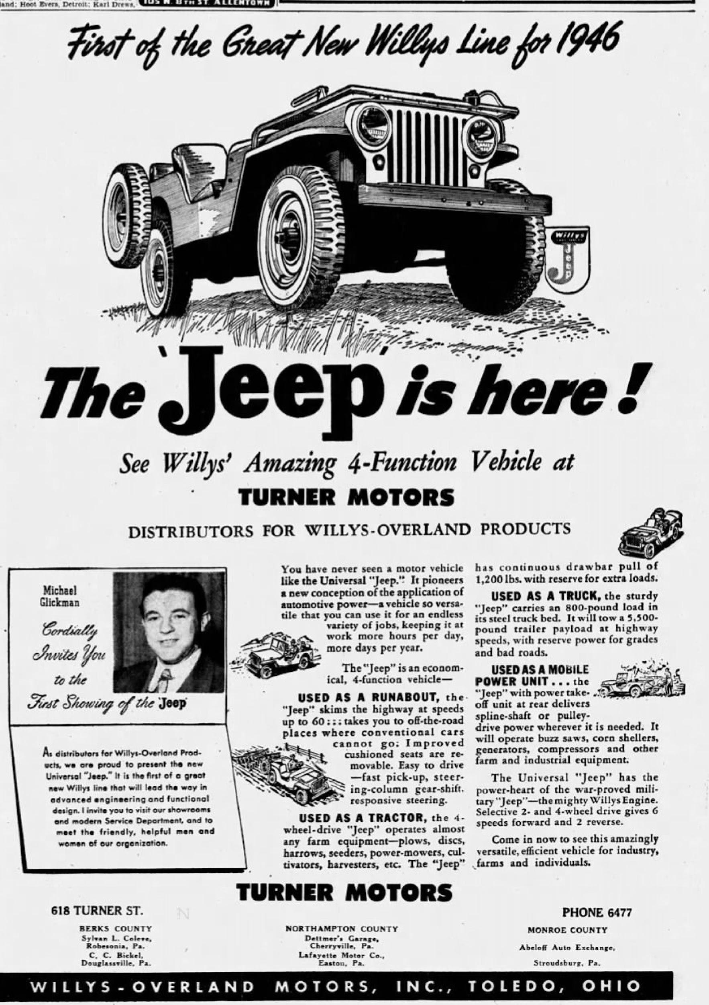
Notes:
Discuss details that students notice about the advertisements. Cost, item being sold, font, letter size, impact, etc.
How might these details attract consumers to the ads? What are ways that we use advertisements? Can an advertisement impact our perception of a product’s value? Why are they important? Millions of dollars are spent on advertisements to get consumers to consume.

Slide 4
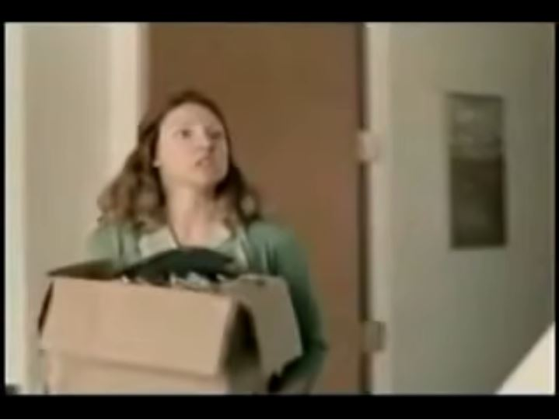
Notes:
https://www.youtube.com/watch?v=Nfh92hKLO6c

Slide 5
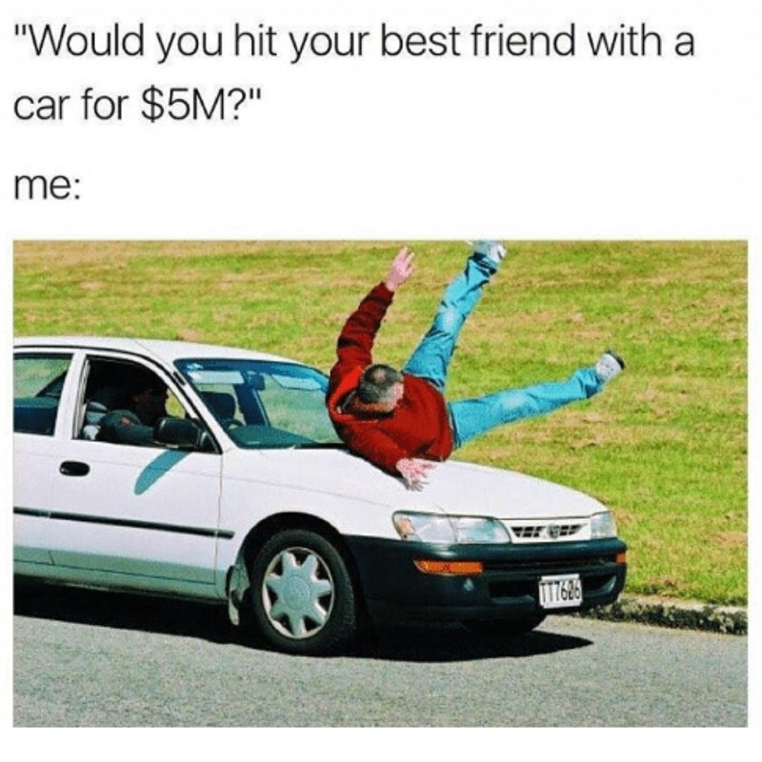
How much would you sell your family for?
Notes:
Discuss the value of a person. How much are people worth? Does this depend on the person (for example, someone you respect versus someone you do not; someone in your family versus a stranger)? And when we think of a person’s worth, do we usually think in terms of monetary value?
Again, using light humor to play on the concepts: “Who would you be willing to hit for money?” This question forces us to think about a person’s worth and our perceived value of certain humans. Is that person worth more than a million dollars?

Slide 6
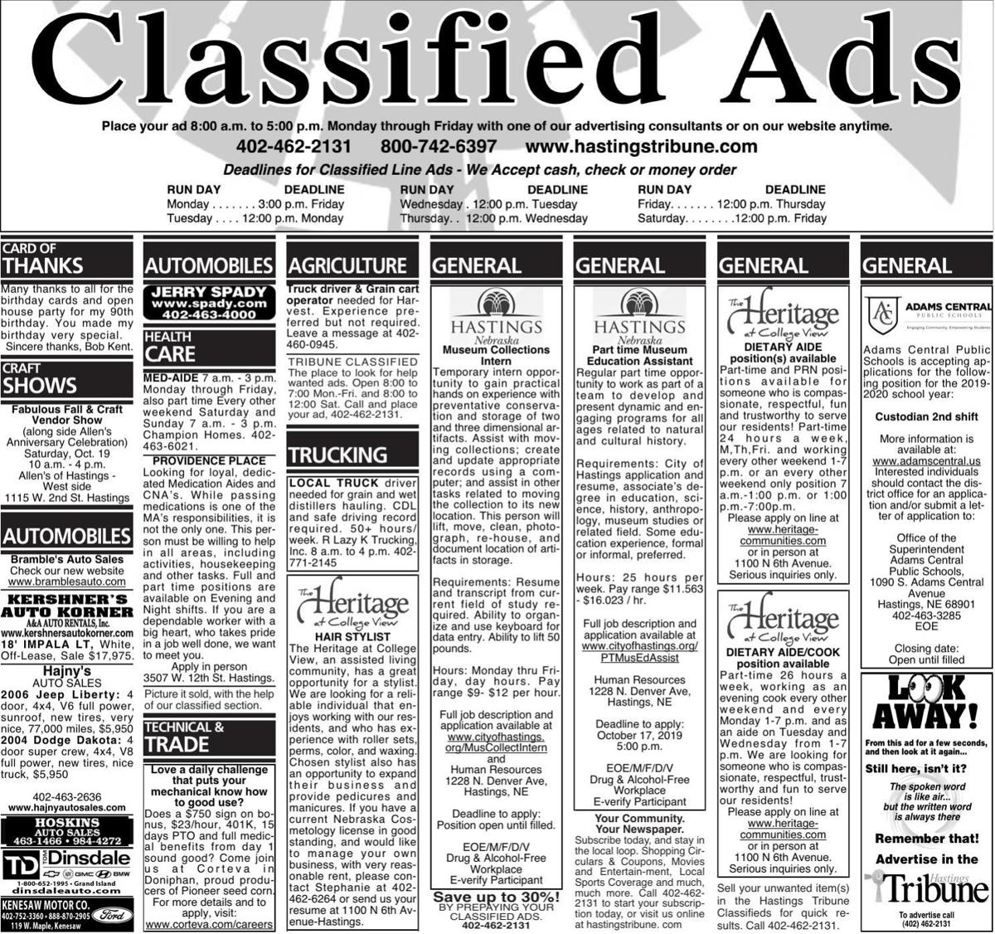
Have you ever seen these? What are the modern day Classifieds?
Notes:
Discuss the purpose of Classified Ads (an advertisement generally dealing with offers of or requests for jobs, services, houses, used cars, etc.). What do Classified Ads sell? Do we see them as much anymore?
What is the modern day Classified? (Craigslist, Facebook Marketplace)

Slide 7
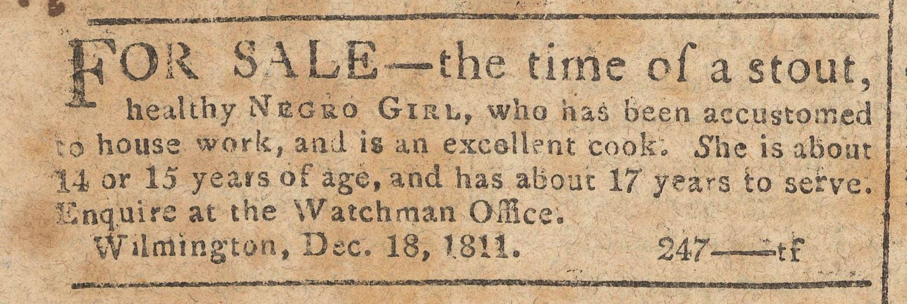
S L A V E A D S
Notes:
Advertisement for sale of enslaved girl in the American Watchman, January 1, 1812 - https://digital.dehistory.org/advertisement-sale-enslaved-girl-american-watchman-january-1-1812
Show Slave Ads. What do the students notice? Discuss the location of the slave ads. Many may think that there were no enslaved people in New Castle County, but the advertisements show that was not the case. Was Delaware a state in which slavery was legal or illegal? Where was the line that divided states where slavery was legal from states where slavery was illegal? What have you been taught as a child? Discuss the Mason-Dixon Line, its original purpose, and its later significance to slavery.
How does viewing the ads make the students feel?
Equate value of a dollar in 1860 to the value of a dollar today. What can be purchased? Determine how much the enslaved in the ads were considered to be worth. Relate the monetary value assigned to these individuals to the earlier discussion points on perceived human worth and value.
Discuss the economic impact of cotton in the North versus the South. Why would banks be willing to use a human as collateral to recoup their money?
Modern day equivalent- Walmart’s Dead Peasant Insurance.

Slide 8
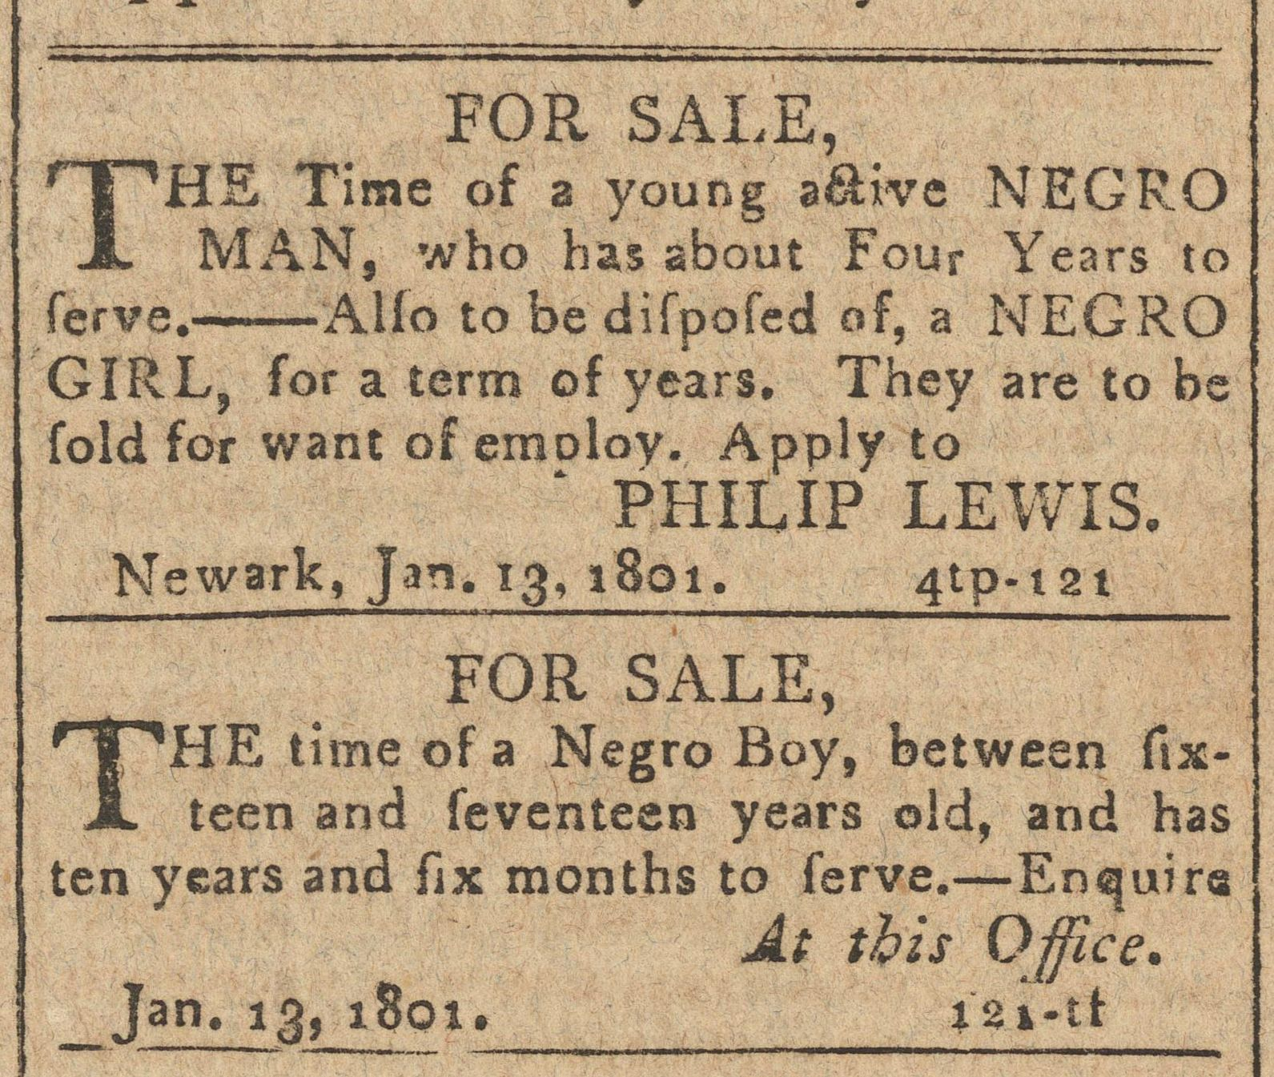
Notes:
Two advertisements for the sale of enslaved people in the Mirror of the Times, January 14, 1801 - https://digital.dehistory.org/two-advertisements-sale-enslaved-people-mirror-times-january-14-1801

Slide 9
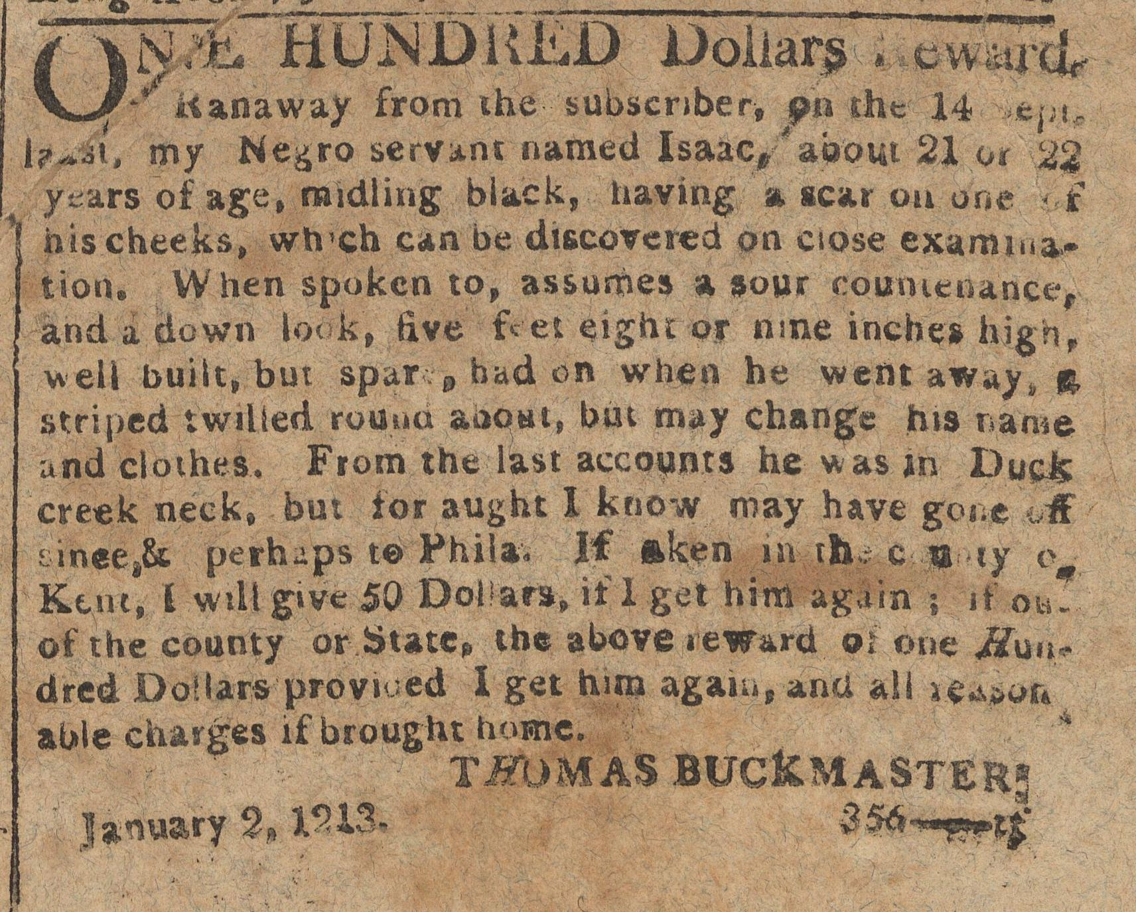
Notes:
Advertisement, reward for freedom seeker Isaac in the American Watchman, January 2, 1813 - https://digital.dehistory.org/advertisement-reward-freedom-seeker-isaac-american-watchman-january-2-1813

Slide 10
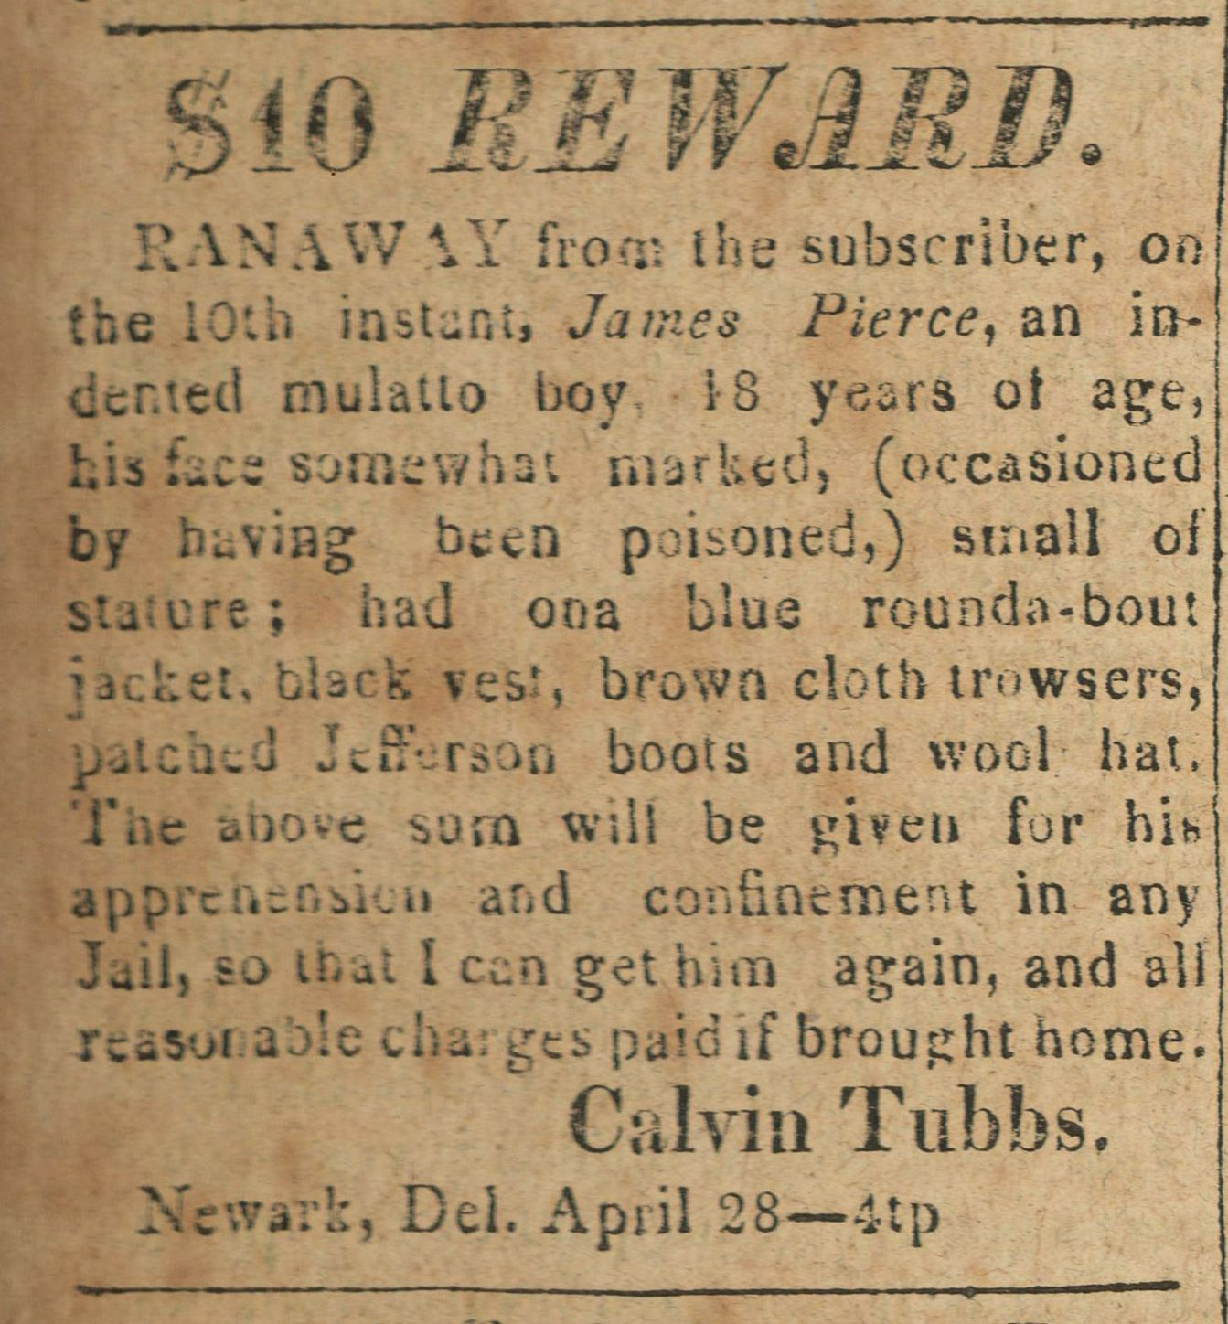
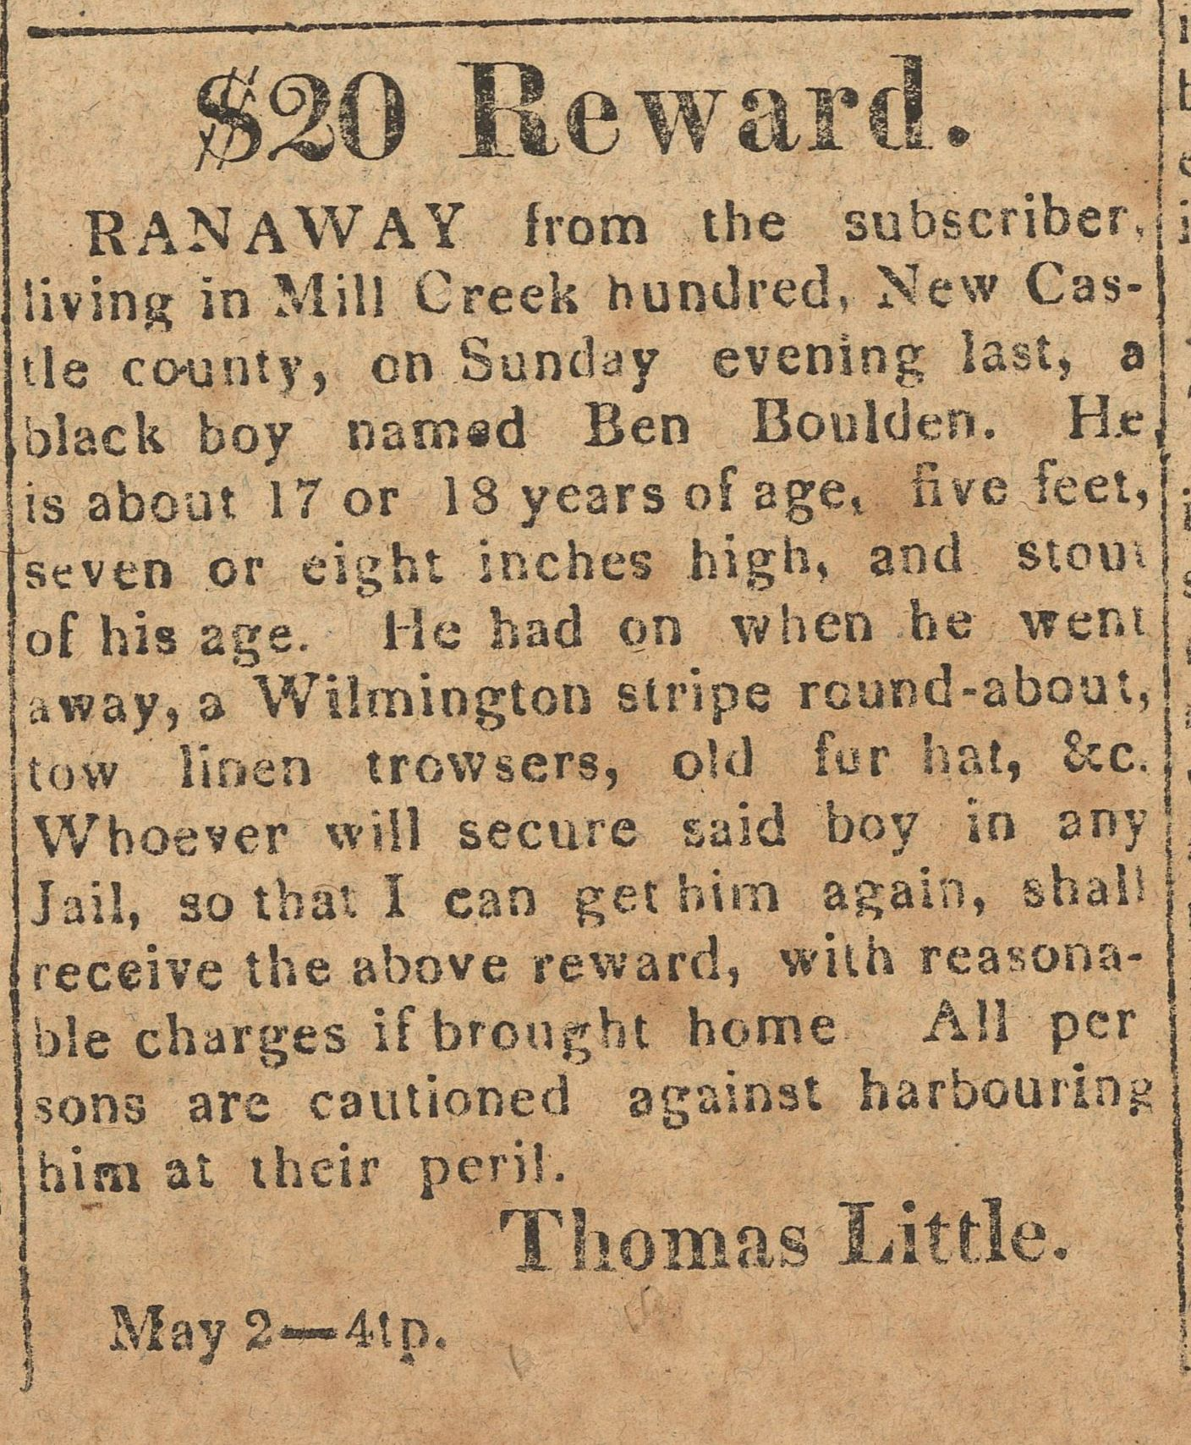
Notes:
Advertisement, reward for James Pierce in the Delaware Gazette, May 5, 1826 - https://digital.dehistory.org/advertisement-reward-james-pierce-delaware-gazette-may-5-1826
Advertisement, reward for freedom seeker Ben Boulden in the Delaware Gazette, May 5, 1826 - https://digital.dehistory.org/advertisement-reward-freedom-seeker-ben-boulden-delaware-gazette-may-5-1826

Slide 11
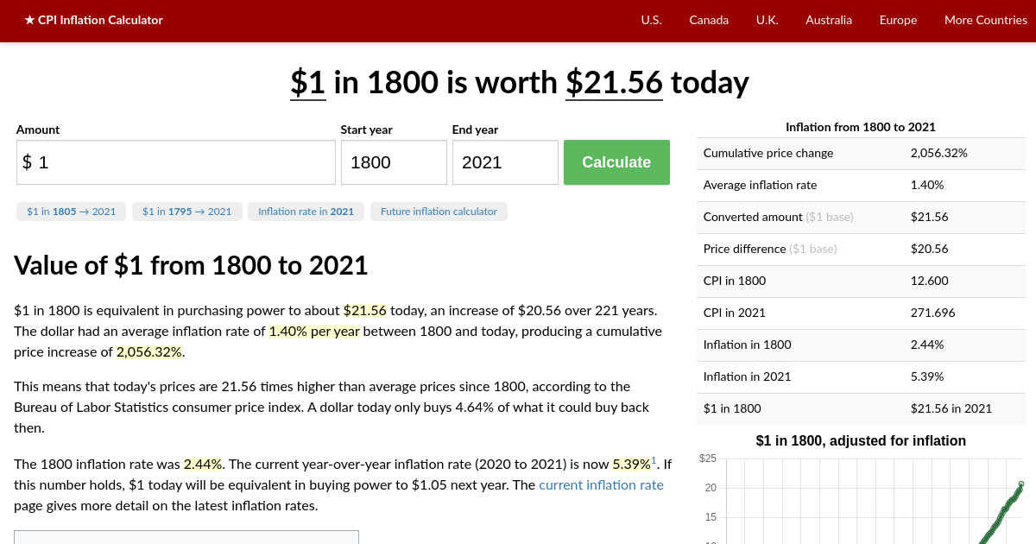
The price of $1 in 1800:
So a $10 reward would be $215

Slide 12
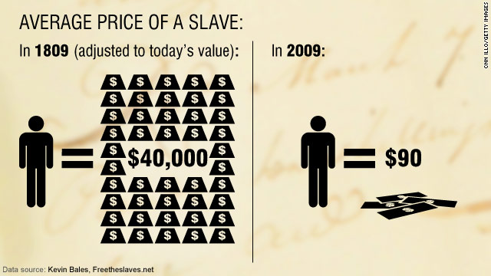
Does that really say $90?!

Slide 13
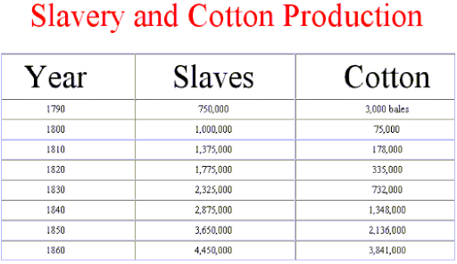
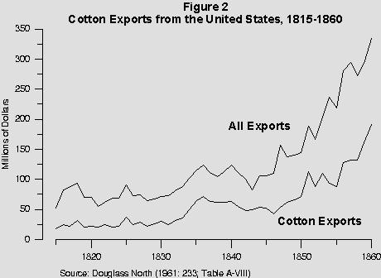
Price of Cotton & Economic Impact

Slide 14
Banking Institutions
What is Life Insurance?
How do you feel about the fact that enslaved people were insured by their enslavers?
Walmart may have done the same-Dead Peasant Insurance
Notes:
JPMorgan: Predecessors linked to slavery—NBC News
https://www.nbcnews.com/id/wbna6851727
JP Morgan admits US slavery links—BBC
http://news.bbc.co.uk/2/hi/business/4193797.stm
What is dead peasant insurance?—Policygenius
https://www.policygenius.com/life-insurance/dead-peasant-insurance/

Slide 15
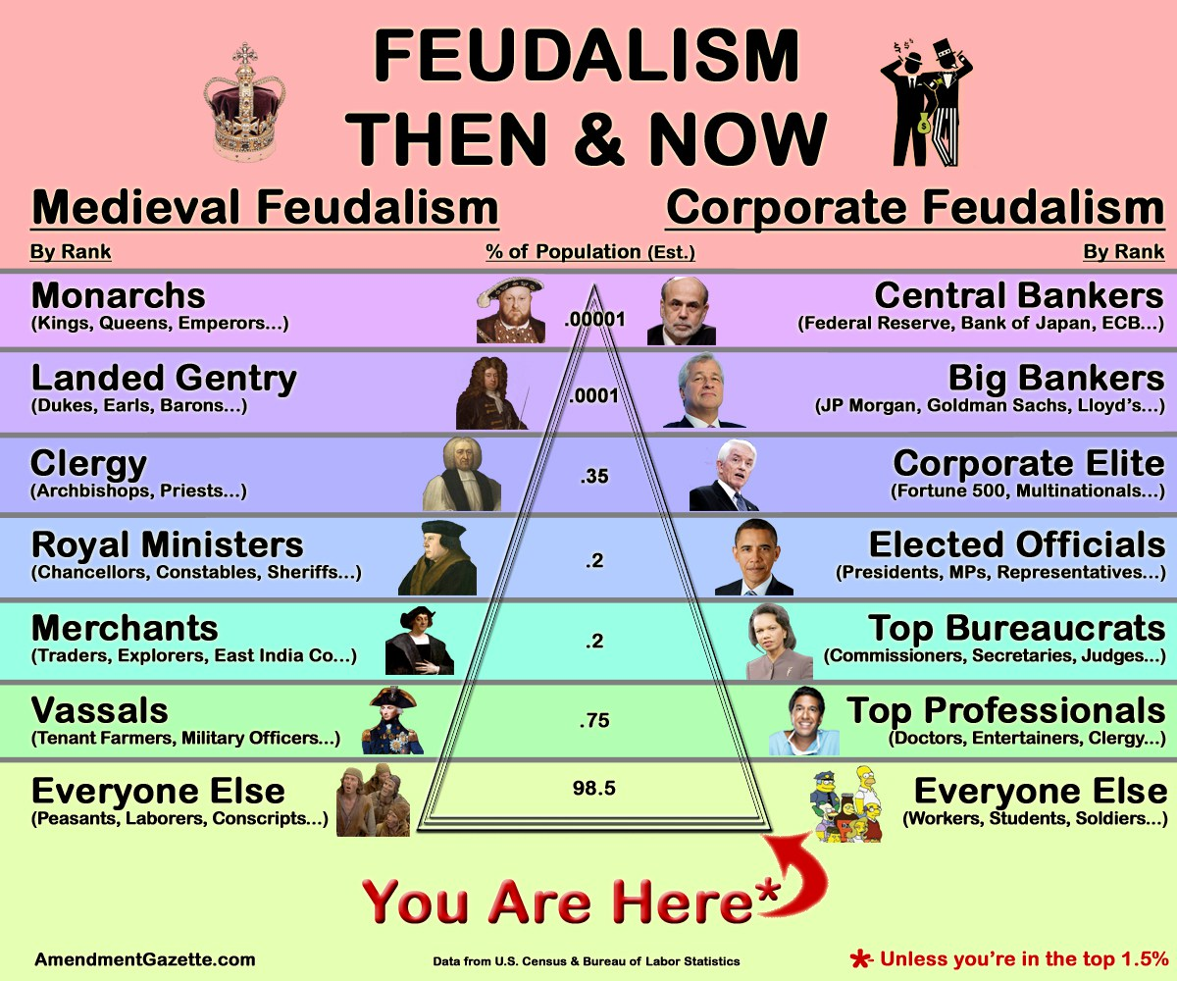
Generational Wealth
…is wealth that is passed down from one generation to the next. You may also hear this called family wealth or legacy wealth. This wealth can come in many forms, such as real estate assets, stock market investments, or a financial education to carry forward into the future.

Slide 16
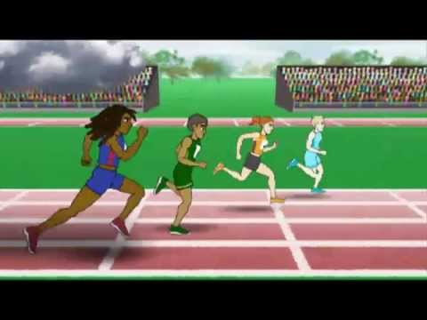
Notes:
Unequal Opportunity Race
https://www.youtube.com/watch?v=vX_Vzl-r8NY

Slide 17
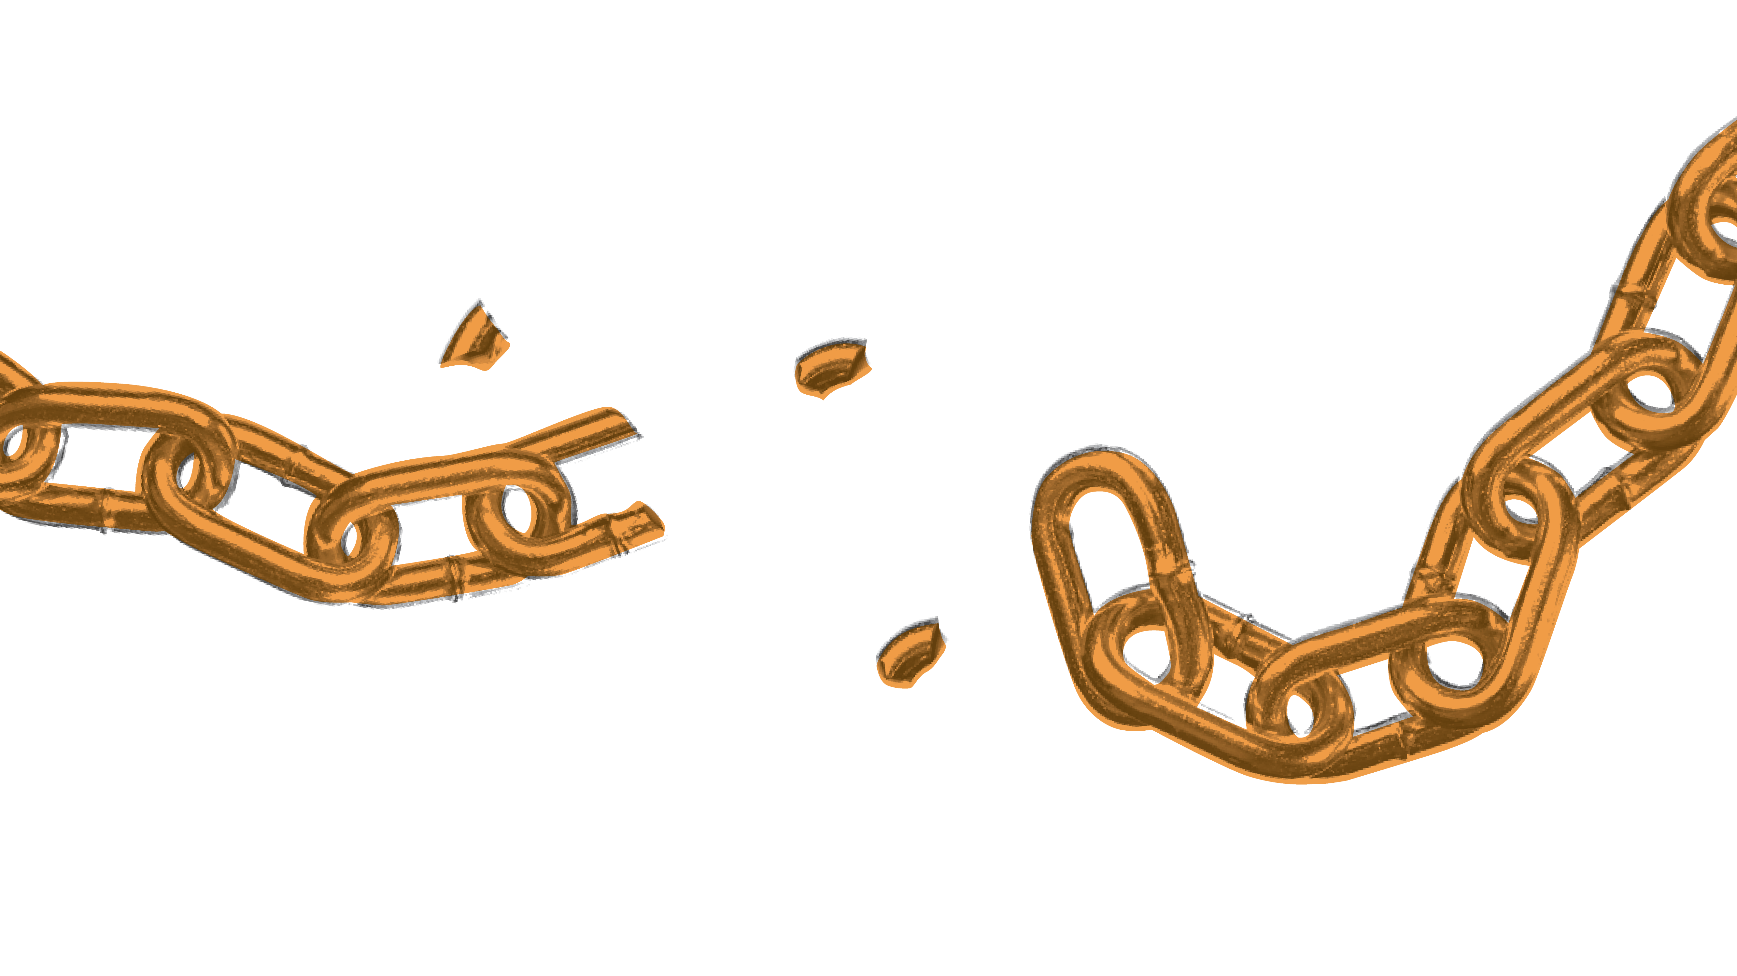
Was enslavement a choice?
Or was it systems put
in place to keep people in a state
of secondary citizenship?

Slide 18
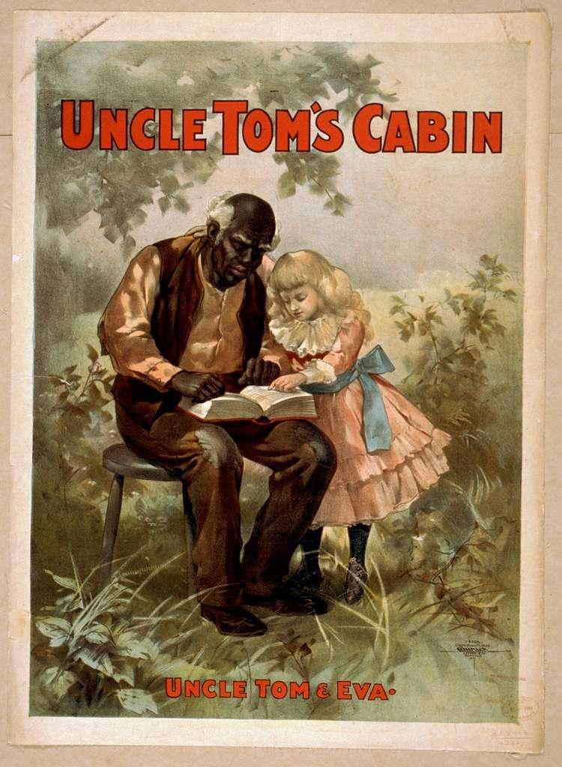
Uncle Tom’s Cabin
Published in 1850s
Written by Harriet Beecher Stowe
Considered one of the Causes of the Civil War?
Showed life in the South
Notes:
Uncle Tom’s Cabin book summary:
https://www.britannica.com/topic/Uncle-Toms-Cabin

Slide 19
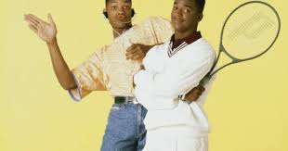
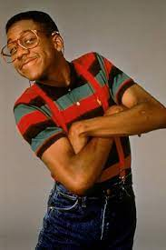
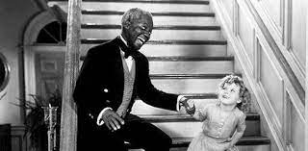
What is an
Uncle Tom?

Slide 20
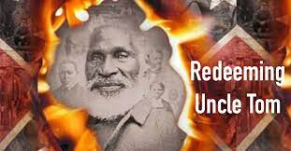
Notes:
Redeeming Uncle Tom video:
https://tubitv.com/movies/595345/redeeming-uncle-tom

Slide 21
Think about the regulatory systems of the period of enslavement.
Are there any systems that you feel are still in place today?
Why more enslaved people did not run away?
Where can they go?
Couldn't read or write, swim, read maps
Slave patrols; precursors for Southern police force; Fugitive Slave Acts
Tracking movement; brandings-mutilations
Why don't people leave an underserved area?
Limited resources and opportunity
Unequal education systems
Modern Policing/Black Lives Matter/Officer involved shootings; Prison Industrial Complex
Cell phones, jails, background checks, records

Slide 22
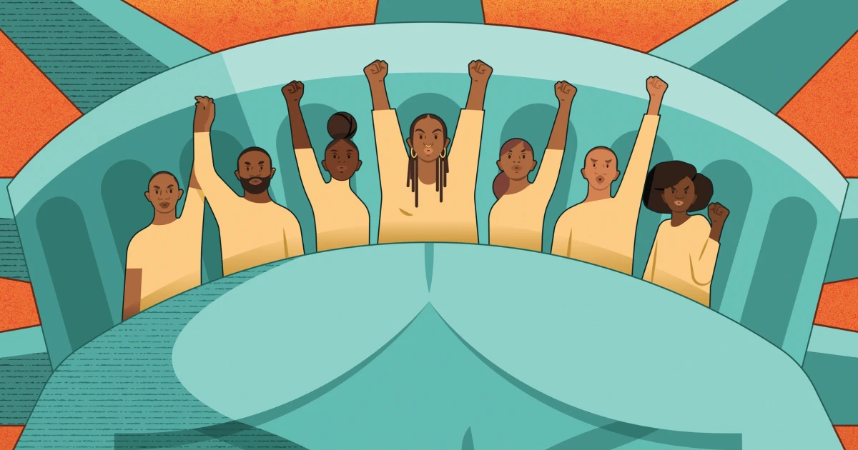
SO WHAT NOW?
How do we use this information?

