Slide 1
Suffrage in the News
Why didn’t Delaware support the ratification of the 19th Amendment?

Slide 2
Standards Addressed
9-12a: Students will develop and implement effective research strategies for investigating a given historical topic. Grade 11 and 12
9-12b: Students will examine and analyze primary and secondary sources in order to differentiate between historical facts and historical interpretations. Grade 11 and 12

Slide 3
Essential Questions
Why didn’t Delaware support the ratification of the 19th Amendment?

Slide 4
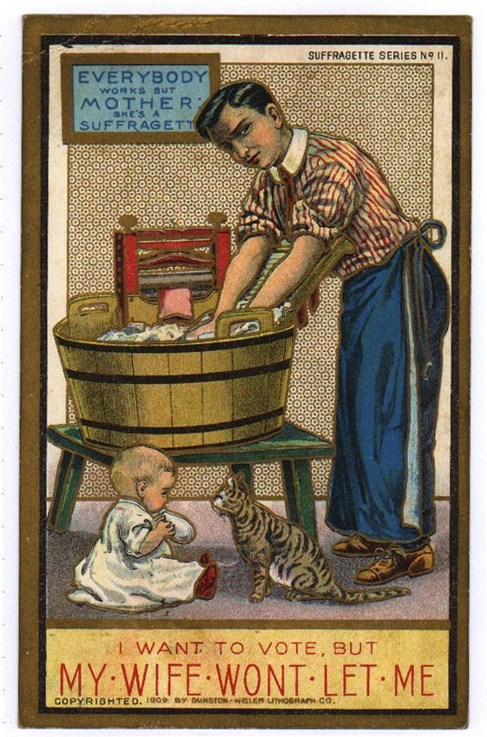
Warm Up
Who created this postcard?
Who was the intended audience?
What is the point of view of the artist who created this post card?
How do you know?
Source: Cartoon postcards produced by the Dunston-Weiler Lithograph Company of New York opposing woman suffrage.1909. Palczewski, Catherine H. Postcard Archive. University of Northern Iowa. Cedar Falls, IA.
Notes:
Ask students:
Who created this post card?
Who was the intended audience?
What is the artist trying to say?
How do you know?
Add other questions as necessary.

Slide 5
Historical Context
Seneca Falls Convention- July 1848
Women organize, lobby and protest for a suffrage amendment
1870’s- ask Congress to vote on suffrage amendment
June 1919- Congress finally votes on 19th Amendment
36 states need to ratify
Aug. 18, 1920- Tennessee becomes the 36th state to ratify the 19th Amendment
Notes:
This slide intentionally provides minimal information. Add information and background to suit your purposes (see lesson plan document).

Slide 6
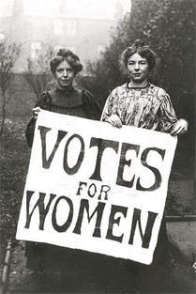
19th Amendment
"The right of citizens of the United States to vote shall not be denied or abridged by the United States or by any state on account of sex."

Slide 7
Delaware & The 19th Amendment
Delaware had some notable suffragists
Mabel Vernon, Florence Bayard Hilles, Alice Dunbar Nelson, and more
June 2, 1920- Delaware votes to reject ratification of the amendment
March 6, 1923- Delaware ratified the 19th Amendment
Woman Suffrage Timeline (1840-1920)
Delaware and the 19th Amendment, National Park Service
Notes:
Fill in relevant dates from timeline in lesson document to suit your needs.

Slide 8
Historical Thinking Skill: Research
-The Delaware Digital Newspaper Project is a digital collection of Delaware newspapers from 1789-1963
-Can use this tool to read newspapers from the past
-Collection is growing as more newspapers are scanned!

Slide 9
Let’s Practice
Essential Question: Why didn’t Delaware support the ratification of the 19th Amendment?
-What years should we use in our search?
-What search terms should we use?

Slide 10
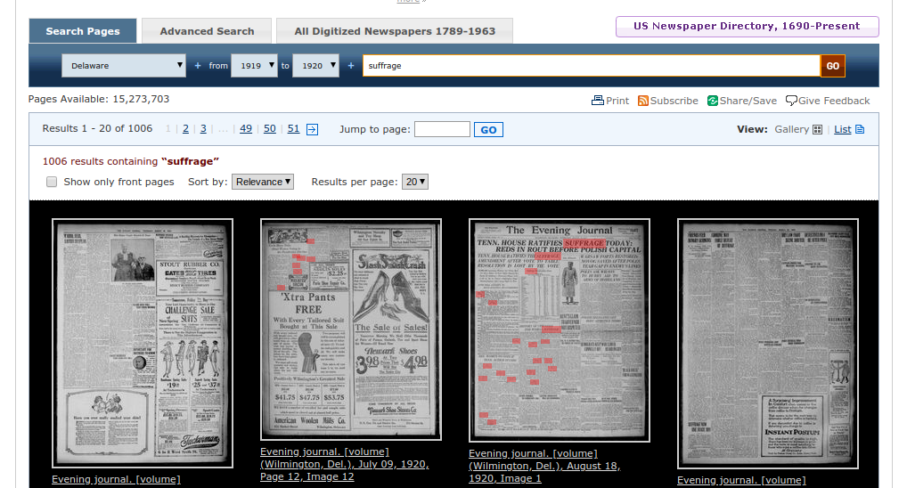
Search Results
Years: 1919-1920 Search Term: Suffrage Results: 1006

Slide 11
Practice Looking at a Search Result

Slide 12
Activity 1: Independent Practice
Steps:
With a partner, go to the Delaware Digital Newspaper Project (DDNP)
Find one newspaper article related to Delaware’s debate over the suffrage amendment.
Download the article in the desired format.

Slide 13
Historical Thinking Skill: Fact v. Interpretation
Fact: a thing that is known, or proved to be true
Interpretation: the action of explaining the meaning of something
Discussion: why are both of these essential to the study of history?

Slide 14
Activity 2, Step 1
Read your newspaper clip and completed the following table:
Newspaper (title, date)
Facts:
Interpretations:

Slide 15
Activity 2, Step 2
Debrief:
-Take turns sharing out your article findings.
-Do the different articles agree on the facts? Are there similar interpretations or different interpretations?
-How do these articles help us understand why Delaware didn’t ratify the 19th Amendment?

Slide 16
Write about it!
Why didn’t Delaware ratify the 19th Amendment?
Answer using evidence from your sources!
After completing your paragraph, use a highlighter to indicate where you made historical interpretations.

